Slide 1
OAuth 2.0- Secure REST API
Soham Sengupta

Slide 2
What is OAuth?
History of evolution of Oauth – https://www.slideshare.net/aaronpk/an-introduction-to-oauth-2/9-aaronpkoauth2_aaronpk
Oauth 1.x to 2.0
Many standards and use cases
Single Sign On , CAS
Further reading - https://www.drupal.org/node/1827698

Slide 3
Play as we Learn- Learn-as-we-Play
download the project https://github.com/trainerpb/training/tree/master/OauthDemo2_AuthServer
Import it into your Eclipse /IDE as a MAVEN project
It might take a few minutes for MAVEN dependencies to download to your local MAVEN repository i

Slide 4
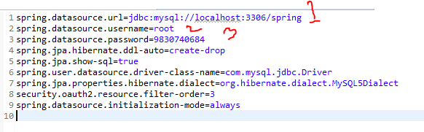
Pre-requisite – and Set-up
Java 8
Eclipse 4.2 or above with MAVEN
Well, you’ll need MySQL
Create a database spring or change the same in application.properties

Slide 5
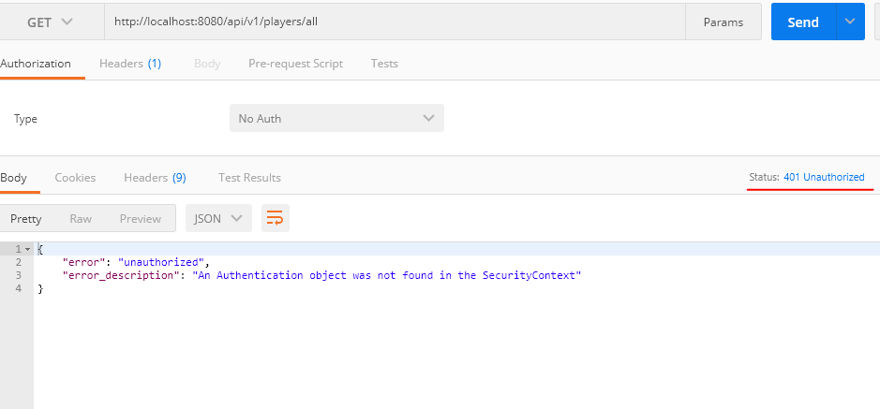
Run the project
com.soham.oiathdemo2.authserver.MainApplication_AuthServer –execute the main class of the Spring Boot application
Now let’s try to access the REST API to fetch all players
HTTP 1.1 / GET http://localhost:8080/api/v1/players/all
You won’t be able to access it

Slide 6
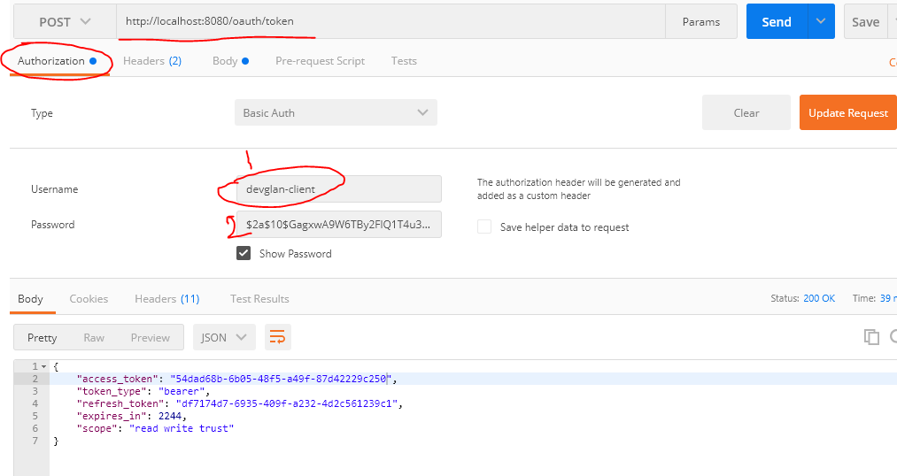
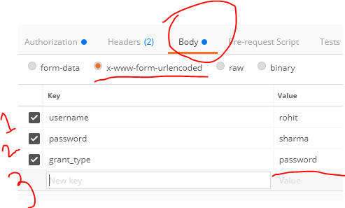
Generate Token
POST request URL: http://localhost:8080/oauth/token
HTTP Basic Auth
Username same as client-id
Password same as client-secret
Payload Body : x-form-urlencoded, username, password, grant_type

Slide 7
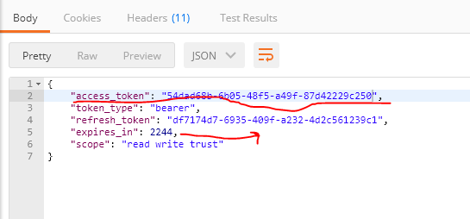
Finally here you got your tokens

Slide 8
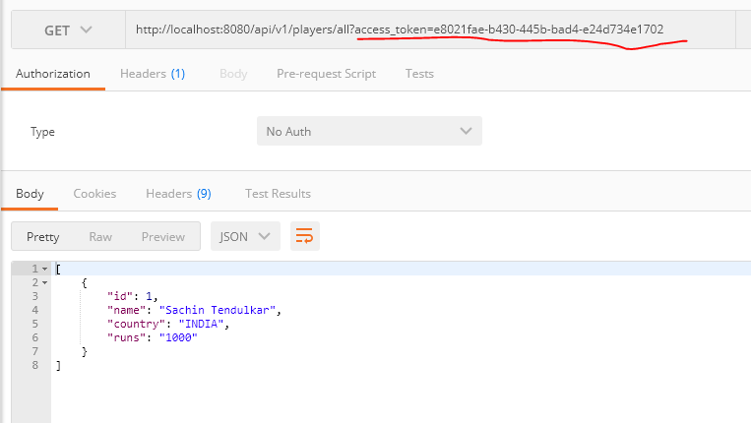
Pass this access_token in requests

Slide 9
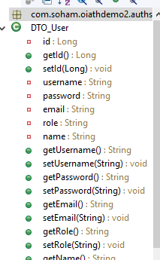
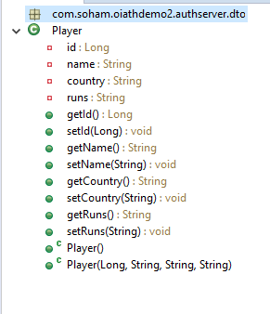
Codes explained
We have two Models
DTO_User represents user of
the system
DTO_Player represents a
Resource which we access via API

Slide 10
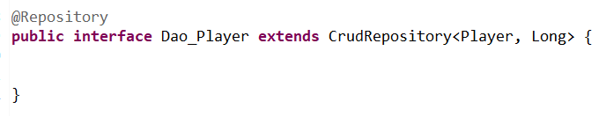
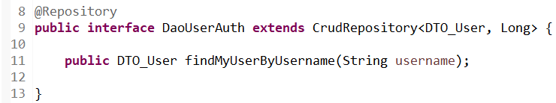
We have Crud Repositories for both

Slide 11
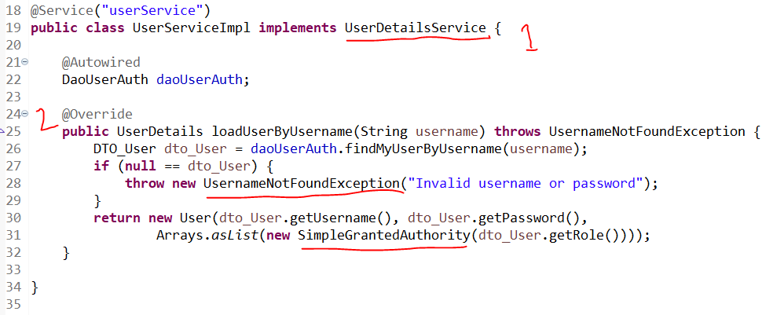
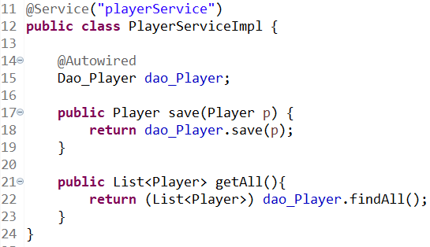
@Service for both

Slide 12
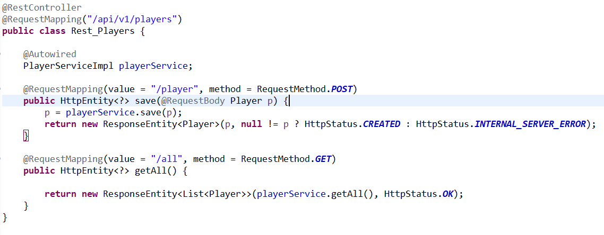
The Players-REST API

Slide 13
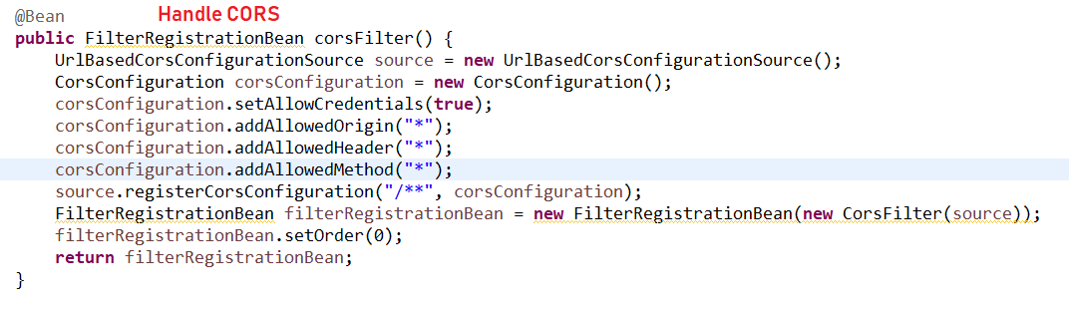
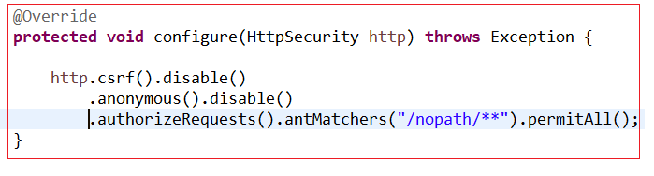
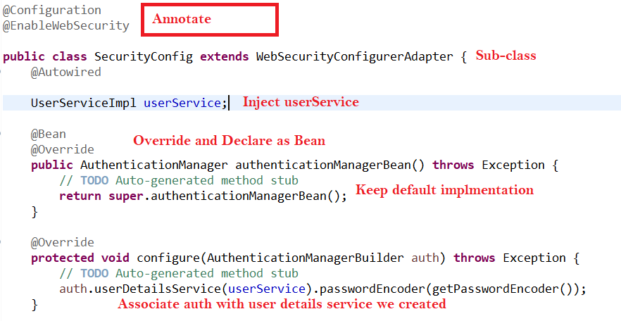
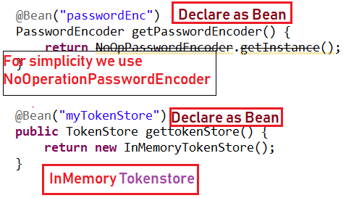
Into WebSecurityConfigurerAdapter
Sub-class WebSecurityConfigurerAdapter

Slide 14
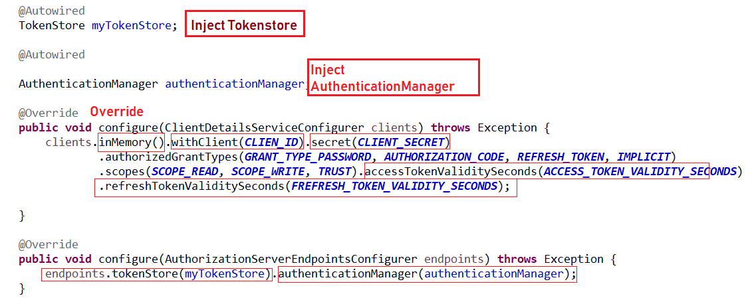
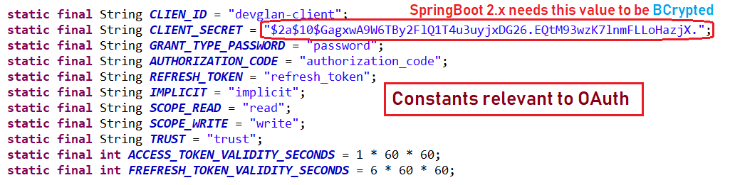
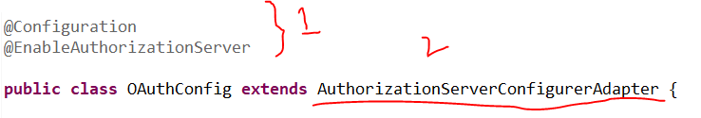
Create Authorizing Server

Slide 15
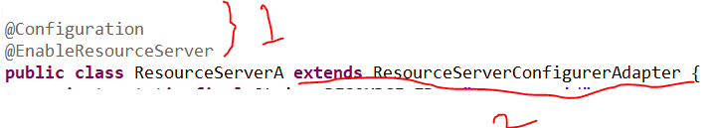
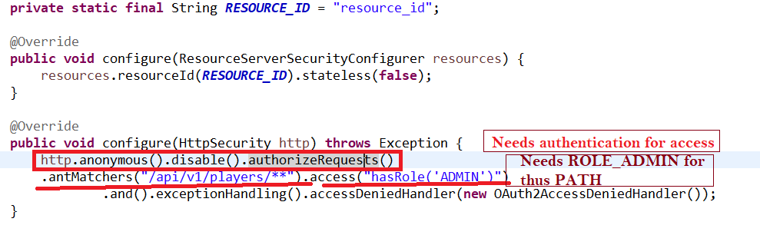
Resource Server-

Slide 16

Initially populate user database
We created 2 users
rohit→ ROLE_EMP
virat → ROLE_ADMIN

Slide 17
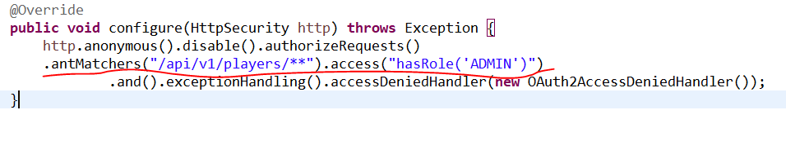
Only virat can access Players API
Access Token generated by logging-in rohit, will not succeed to access the APIs

